Slide 1
Secure Data II: Data Protection & Governance

Slide 2
Securing Against External Threats Reducing Risk Within Your Organization
Defend Users: Phishing & Threat Protection
Protect Devices: Endpoint Security Strategies
Secure Data II: Data Protection & Governance

Slide 3
Handling Oversharing

Slide 4
Oversharing Agenda
1
Intro to Oversharing
2
Oversharing Blueprint
3
Restricted SharePoint Search (Temporary)
4
SharePoint Advanced Management (SAM)
5
Microsoft Purview

Slide 5

Oversharing Agenda
1
Intro to Oversharing
2
Oversharing Blueprint
3
Restricted SharePoint Search (Temporary)
4
SharePoint Advanced Management (SAM)
5
Microsoft Purview

Slide 6
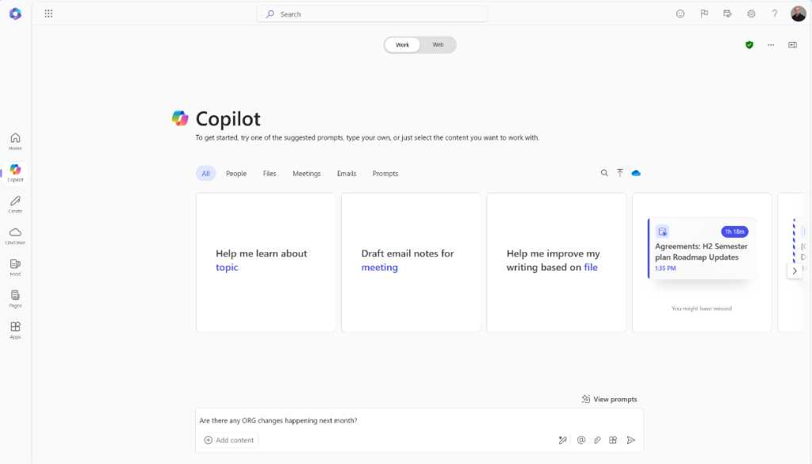
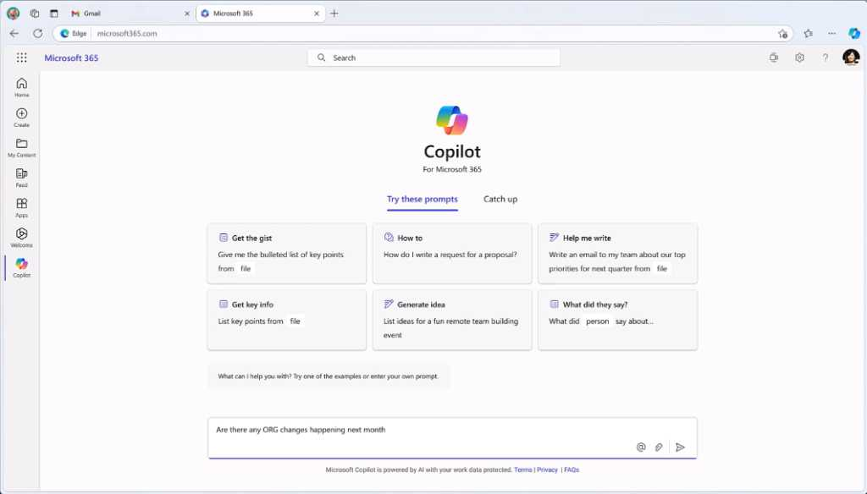
1

Slide 7
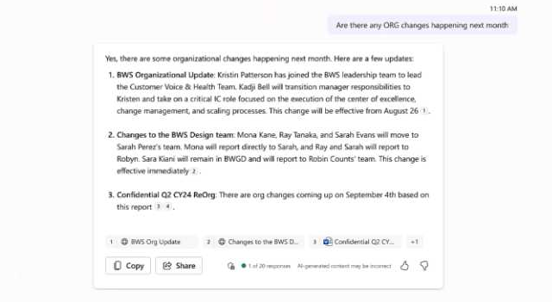
2

Slide 8
3

Slide 9
How Copilot gets access to content
Copilot retrieves only the information you have access to
The process is called “retrieval augmented generation”
1
2
3
4
5
You submit a prompt
Orchestrator determines what it needs to answer the prompt
Orchestrator uses Graph to find relevant info you are allowed to access
Orchestrator appends info to your prompt to enhance it
LLM uses additional that information to generate a response

Slide 10






Microsoft Copilot for Microsoft 365 architecture and content retrieval
Microsoft 365 Service Boundary
Copilot response back to the user
Prompts, responses, and grounding data aren’t used to train foundation models
6
1
Pre-processing
User prompt
Large Language Model
Grounding
Modified prompt
Azure OpenAI instance is maintained by Microsoft. OpenAI has no access to the data or the model
2
3
3
5
4
Compliance and Purview
LLM
response
Azure
OpenAI
Post-processing
RAI
Agents
Bing
RAI is performed on input prompt and output results
Dataverse + Power Platform Services
Microsoft Graph
Data flow ( = all requests are encrypted via HTTPS and wss://)
1
User prompts are sent to Copilot
2
Copilot accesses Graph + (optional) Web + Other services for grounding
3
Copilot sends modified prompt to Large Language Model (LLM)
Your context and content (emails, files, meetings, chats, calendars, and contacts)
4
Copilot receives LLM response
5
Copilot accesses Graph for Compliance and Purview
6
Copilot sends the response back to the user
Customer Microsoft 365 Tenant

Slide 11
Microsoft Copilot for Microsoft 365 architecture and content retrieval
Microsoft 365 Service Boundary
Copilot response back to the user
Prompts, responses, and grounding data aren’t used to train foundation models
6
1
Pre-processing
User prompt
Large Language Model
You submit a prompt
Grounding
Modified prompt
Azure OpenAI instance is maintained by Microsoft. OpenAI has no access to the data or the model
2
3
3
5
4
1
Compliance and Purview
LLM
response
Azure
OpenAI
Post-processing
RAI
Plug-ins
Bing
RAI is performed on input prompt and output results
Dataverse + Power Platform Services
Microsoft Graph
Data flow ( = all requests are encrypted via HTTPS and wss://)
1
User prompts are sent to Copilot
2
Copilot accesses Graph + (optional) Web + Other services for grounding
3
Copilot sends modified prompt to Large Language Model (LLM)
Your context and content (emails, files, meetings, chats, calendars, and contacts)
4
Copilot receives LLM response
5
Copilot accesses Graph for Compliance and Purview
6
Copilot sends the response back to the user
Customer Microsoft 365 Tenant

Slide 12
Microsoft Copilot for Microsoft 365 architecture and content retrieval
Microsoft 365 Service Boundary
Copilot response back to the user
Prompts, responses, and grounding data aren’t used to train foundation models
6
1
Pre-processing
User prompt
Large Language Model
Grounding
Modified prompt
Azure OpenAI instance is maintained by Microsoft. OpenAI has no access to the data or the model
2
3
3
5
4
Compliance and Purview
LLM
response
Azure
OpenAI
Post-processing
RAI
Agents
Bing
RAI is performed on input prompt and output results
Orchestrator determines what it needs to answer the prompt
Dataverse + Power Platform Services
Microsoft Graph
2
Data flow ( = all requests are encrypted via HTTPS and wss://)
1
User prompts are sent to Copilot
2
Copilot accesses Graph + (optional) Web + Other services for grounding
3
Copilot sends modified prompt to Large Language Model (LLM)
Your context and content (emails, files, meetings, chats, calendars, and contacts)
4
Copilot receives LLM response
5
Copilot accesses Graph for Compliance and Purview
6
Copilot sends the response back to the user
Customer Microsoft 365 Tenant

Slide 13
Microsoft Copilot for Microsoft 365 architecture and content retrieval
Microsoft 365 Service Boundary
Copilot response back to the user
Prompts, responses, and grounding data aren’t used to train foundation models
6
1
Pre-processing
User prompt
Large Language Model
Grounding
Modified prompt
Azure OpenAI instance is maintained by Microsoft. OpenAI has no access to the data or the model
2
3
3
5
4
Compliance and Purview
LLM
response
Azure
OpenAI
Post-processing
RAI
Agents
Bing
RAI is performed on input prompt and output results
Orchestrator uses Graph to find relevant info you are allowed to access
Dataverse + Power Platform Services
Microsoft Graph
Data flow ( = all requests are encrypted via HTTPS and wss://)
1
User prompts are sent to Copilot
3
2
Copilot accesses Graph + (optional) Web + Other services for grounding
3
Copilot sends modified prompt to Large Language Model (LLM)
Your context and content (emails, files, meetings, chats, calendars, and contacts)
4
Copilot receives LLM response
5
Copilot accesses Graph for Compliance and Purview
6
Copilot sends the response back to the user
Customer Microsoft 365 Tenant

Slide 14
Microsoft Copilot for Microsoft 365 architecture and content retrieva l
Microsoft 365 Service Boundary
Copilot response back to the user
Prompts, responses, and grounding data aren’t used to train foundation models
6
1
Pre-processing
User prompt
Large Language Model
Grounding
Modified prompt
Azure OpenAI instance is maintained by Microsoft. OpenAI has no access to the data or the model
2
3
3
5
4
Compliance and Purview
LLM
response
Azure
OpenAI
Post-processing
RAI
Agents
Bing
RAI is performed on input prompt and output results
Orchestrator appends info to your prompt to enhance it
Dataverse + Power Platform Services
Microsoft Graph
4
Data flow ( = all requests are encrypted via HTTPS and wss://)
1
User prompts are sent to Copilot
2
Copilot accesses Graph + (optional) Web + Other services for grounding
3
Copilot sends modified prompt to Large Language Model (LLM)
Your context and content (emails, files, meetings, chats, calendars, and contacts)
4
Copilot receives LLM response
5
Copilot accesses Graph for Compliance and Purview
6
Copilot sends the response back to the user
Customer Microsoft 365 Tenant

Slide 15
Microsoft Copilot for Microsoft 365 architecture and content retrieval
Microsoft 365 Service Boundary
Copilot response back to the user
Prompts, responses, and grounding data aren’t used to train foundation models
6
1
Pre-processing
User prompt
Large Language Model
Grounding
Modified prompt
Azure OpenAI instance is maintained by Microsoft. OpenAI has no access to the data or the model
2
3
3
5
4
Compliance and Purview
LLM
response
Azure
OpenAI
Post-processing
RAI
Agents
Bing
RAI is performed on input prompt and output results
LLM uses additional that information to generate a response
Dataverse + Power Platform Services
Microsoft Graph
5
Data flow ( = all requests are encrypted via HTTPS and wss://)
1
User prompts are sent to Copilot
2
Copilot accesses Graph + (optional) Web + Other services for grounding
3
Copilot sends modified prompt to Large Language Model (LLM)
Your context and content (emails, files, meetings, chats, calendars, and contacts)
4
Copilot receives LLM response
5
Copilot accesses Graph for Compliance and Purview
6
Copilot sends the response back to the user
Customer Microsoft 365 Tenant

Slide 16
Internal oversharing: Too much access and too few controls
1
2
Over-permissioning
too much internal access
Under-enforcement
too few internal controls
Bias towards overly broad access for permissions and links
Content looks the same without labeling and content-aware policies to follow its use
Implications
Risk of exposure in search and AI tools
Hard to get started with AI and solve without the right tools

Slide 17




Oversharing is a biproduct of collaboration
Individual user permissions
Group based permissions
Exchange mailbox
Teams channels
Teams chats
Option to share more broadly via link
OneDrive for Business
SharePoint sites
Highest risk of oversharing in Microsoft 365 Copilot

Slide 18
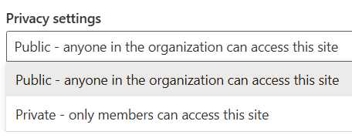
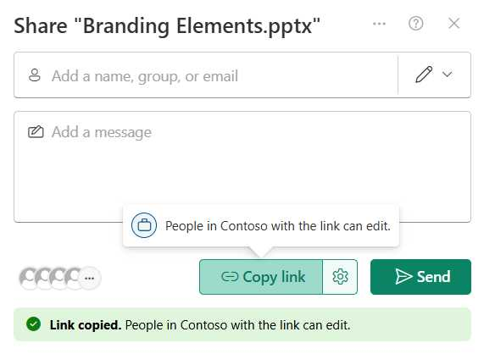
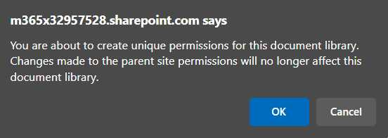
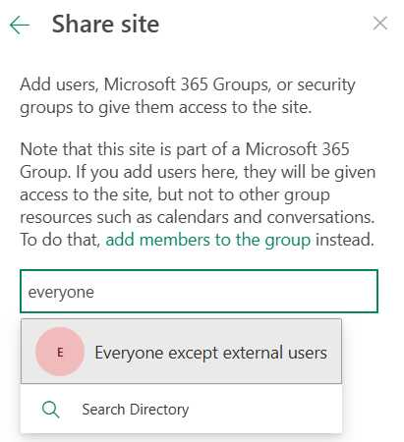
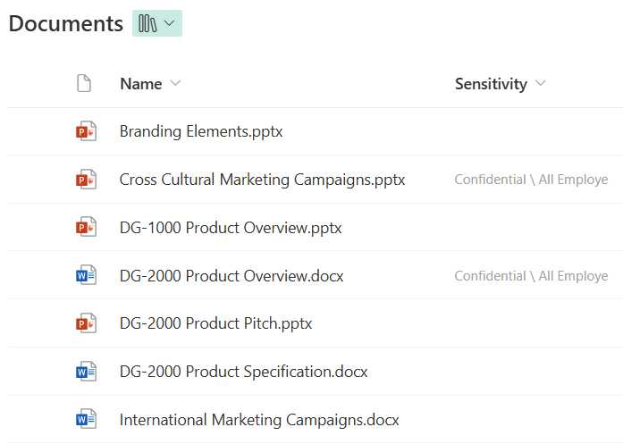
Common causes of Copilot oversharing in SharePoint
Site privacy set to public
Default sharing option is everyone
Broken permission inheritance
Use of “everyone except external users” domain group
Sites and files without sensitivity labels

Slide 19


Two powerful tools to oversharing
Microsoft 365 Copilot
Now powered by SharePoint Advanced Management
Microsoft Purview
Provides SharePoint site management and content governance capabilities
Provides security, compliance, and governance across data and files

Slide 20
Oversharing Agenda
1
Intro to Oversharing
2
Oversharing Blueprint
3
Restricted SharePoint Search (Temporary)
4
SharePoint Advanced Management (SAM)
5
Microsoft Purview

Slide 21




Address internal user oversharing concerns for M365 Copilot deployment
Pilot (optional)
Deploy (at scale)
Operate
Identify most popular sites & assess oversharing
Grant Copilot access to popular, low risk sites
Turn on proactive audit and protection
Discover oversharing risks
Restrict sensitive info from Copilot access and/or processing
Increase site privacy
Further reduce risk and simplify oversight
Further secure sensitive data
Improve Copilot responses
Activities
Outcomes
Deploy copilot to sub-set of users with up to 100 sites
Copilot fully deployed in your organization
Continuous improvement of data security practices
Effort*
2–4 days
2–4 weeks
More than one month
*Suggested efforts should be reviewed into timelines based on your tenant size and organizational complexity
Last updated: Oct 24, 2024

Slide 22
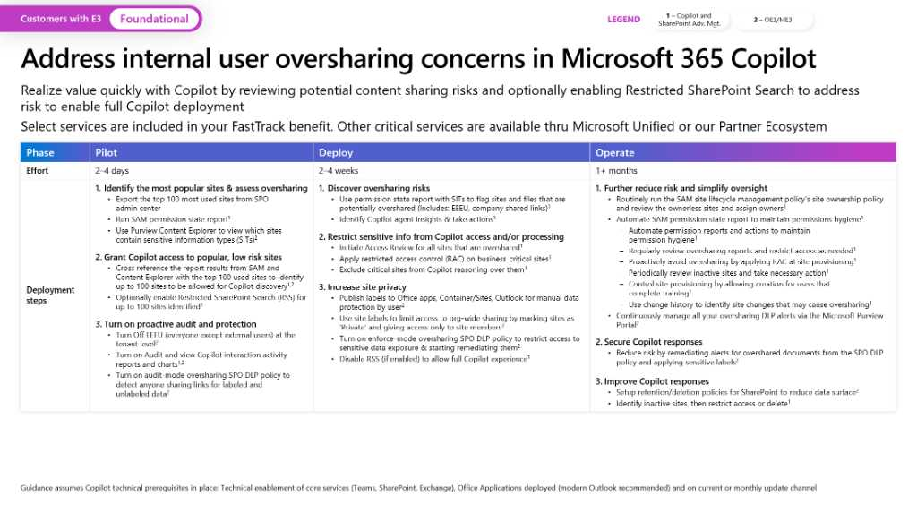
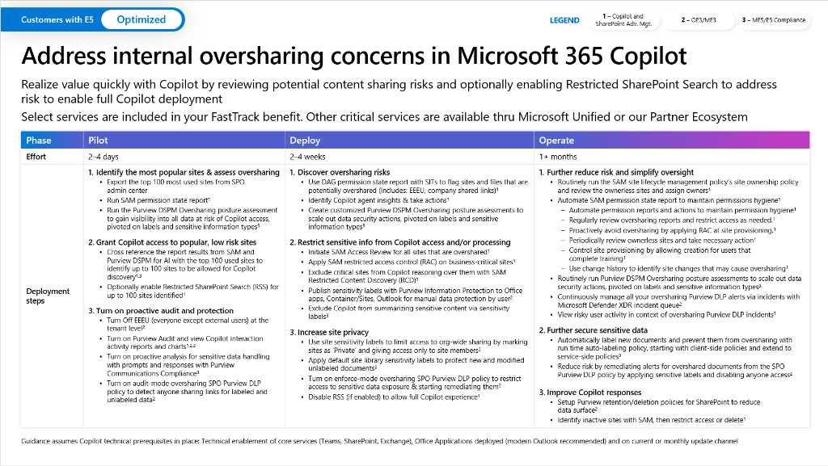
Microsoft deployment blueprint to address internal oversharing in Microsoft 365 Copilot
Get the blueprint:
https://aka.ms/Copilot/OversharingBlueprintLearn

Slide 23
Address internal oversharing concerns in Microsoft 365 Copilot
Customers with E3 or Business Premium
Foundational
LEGEND
1 – Microsoft 365 Copilot
2 – Business Premium or E3
Realize value quickly with Copilot by reviewing potential content sharing risks and optionally enabling Restricted SharePoint Search to address risk to enable full Copilot deployment.
Select services are included in your FastTrack benefit. Other critical services are available thru Microsoft Unified or our Partner Ecosystem.
Phase | Pilot | Deploy | Operate
Effort | 2–4 days | 2–4 weeks | 1+ months
Deployment steps | Identify the most popular sites & assess oversharing Export the top 100 most used sites from SPO admin center Run SAM permission state report¹ Use Purview Content Explorer to view which sites contain sensitive information types (SITs)² Grant Copilot access to popular, low risk sites Cross reference the report results from SAM and Content Explorer with the top 100 used sites to identify up to 100 sites to be allowed for Copilot discovery^{1,2} Optionally enable Restricted SharePoint Search (RSS) for up to 100 sites identified¹ Turn on proactive audit and protection Turn Off EEEU (everyone except external users) at the tenant level² Turn on Audit and view Copilot interaction activity reports and charts^{1,2} Turn on audit-mode oversharing SPO DLP policy to detect anyone sharing links for labeled and unlabeled data² | Discover oversharing risks Use permission state report with SITs to flag sites and files that are potentially overshared (Includes: EEEU, company shared links)¹ Identify Copilot agent insights & take actions¹ Restrict sensitive info from Copilot access and/or processing Initiate Access Review for all sites that are overshared¹ Apply restricted access control (RAC) on business-critical sites¹ Exclude critical sites from Copilot reasoning over them¹ Increase site privacy Publish labels to Office apps, Container/Sites, Outlook for manual data protection by user² Use site labels to limit access to org-wide sharing by marking sites as ’Private’ and giving access only to site members² Turn on enforce-mode oversharing SPO DLP policy to restrict access to sensitive data exposure & starting remediating them² Disable RSS (if enabled) to allow full Copilot experience¹ | Further reduce risk and simplify oversight Routinely run the SAM site lifecycle management policy’s site ownership policy and review the ownerless sites and assign owners¹ Automate SAM permission state report to maintain permissions hygiene¹ Automate permission reports and actions to maintain permission hygiene¹ Regularly review oversharing reports and restrict access as needed¹ Proactively avoid oversharing by applying RAC at site provisioning¹ Periodically review inactive sites and take necessary action¹ Control site provisioning by allowing creation for users that complete training¹ Use change history to identify site changes that may cause oversharing¹ Continuously manage all your oversharing DLP alerts via the Microsoft Purview Portal² Further secure sensitive data Reduce risk by remediating alerts for overshared documents from the SPO DLP policy and applying sensitive labels² Improve Copilot responses Setup retention/deletion policies for SharePoint to reduce data surface² Identify inactive sites, then restrict access, archive or delete¹
Guidance assumes Copilot technical prerequisites in place: Technical enablement of core services (Teams, SharePoint, Exchange), Office Applications deployed (modern Outlook recommended) and on current or monthly update channel
Learn how to use the features in the blueprint and how these features impact Microsoft 365 Copilot: https://aka.ms/E3PrepareYourDataForCopilot

Slide 24
Oversharing Agenda
1
Intro to Oversharing
2
Oversharing Blueprint
3
Restricted SharePoint Search (Temporary)
4
SharePoint Advanced Management (SAM)
5
Microsoft Purview

Slide 25

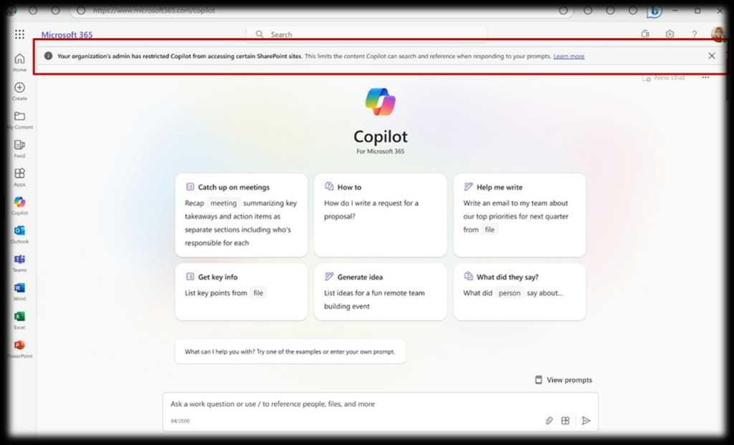



Restricted SharePoint Search
Temporary mitigation for customers where oversharing of data is a concern
Impacts Copilot and organization-wide Search
Restricts the scope of search to site whitelist
Workaround to unlock Copilot deployment

Slide 26




Which data can Copilot still retrieve & use with RSS enabled?
Allowed list of curated SharePoint sites setup by admin
User’s content such as OneDrive files, chats, emails and calendar
Files from their frequently visited SharePoint sites
Files that were shared directly with the user
Files that the users viewed, edited or created

Slide 27
Enable SharePoint Restricted Search
Step | Description | Example
1 | Get the current mode that is set for Restricted Search | Get-SPOTenantRestrictedSearchMode
2 | Enable Restricted Search | Set-SPOTenantRestrictedSearchMode -Mode Enabled
3a | Add sites using a list | Add-SPOTenantRestrictedSearchAllowedList -SitesList @(“[https://contoso.sharepoint.com/sites/Marketing](https://contoso.sharepoint.com/sites/Marketing)”, “[https://contoso.sharepoint.com/sites/Benefits](https://contoso.sharepoint.com/sites/Benefits)”)
3b | Add sites using a CSV file | Add-SPOTenantRestrictedSearchAllowedList -SitesListFileUrl C:\Users\admin\Downloads\UrlList.csv

Slide 28
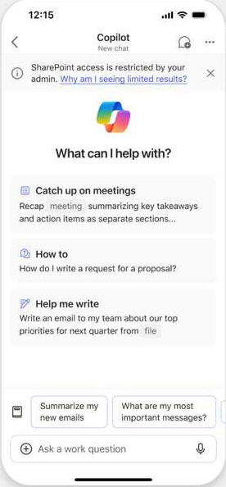
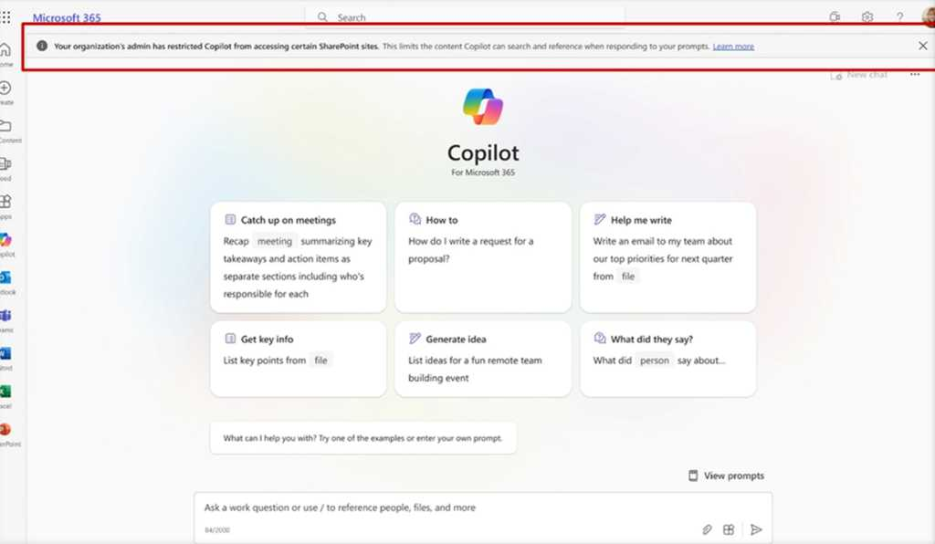
End-User Experience

Slide 29

Restricted SharePoint Search - Key Takeaways
Not a “Copilot” Feature
Should only be considered if your Copilot deployment is blocked due to file oversharing concerns
A temporary solution: allows full Copilot deployment, and in parallel, implementation of security controls as needed (SAM/Purview) to address oversharing concerns
Does not modify permissions or sharing controls on content
Will impact other org-wide search experiences in Microsoft 365

Slide 30
Oversharing Agenda
1
Intro to Oversharing
2
Oversharing Blueprint
3
Restricted SharePoint Search (Temporary)
4
SharePoint Advanced Management (SAM)
5
Microsoft Purview

Slide 31
Govern Copilot content access and quality with SAM
SharePoint Advanced Management enhances content governance for SharePoint and OneDrive, streamlining content management and preventing content sprawl and oversharing
Content Sprawl
Content Oversharing prevention
Site Lifecycle

Slide 32
SharePoint Advanced Management capabilities
Oversharing and accidental sharing Lack of built-in tools and access policies puts content at risk.
Sprawl of SharePoint sites content Governing ever-increasing digital content is critical for every SharePoint or IT admins.
Content lifecycle management Lack of advanced management tools to continuously monitor and govern inactive/active SharePoint sites content make it hard to meet various access and regulatory requirements, such as GDPR, FINRA.
SAM Capabilities
SharePoint data access governance (DAG) insights Quickly identify overshared sites and request sites access review by site owners.
Restricted access control (RAC) for SharePoint sites Limit access to specific SharePoint sites and stop oversharing in seconds.
Restricted access control (RAC) for OneDrives Limit access to OneDrive's across the tenant to specific users (e.g., full-time employees) in seconds.
Conditional access policies for SharePoint and OneDrive sites (CAPS) Add conditions like MFA or Managed device to access sites with business-critical content.
Block download policy for SharePoint and OneDrive sites Block download of content to prevent accidental oversharing or data loss. Block the download of Teams meeting recording files from SharePoint or OneDrive Block download of Teams recording for anyone in the company
SharePoint data access governance (DAG) insights Quickly identify most important sites to your organization
Inactive SharePoint sites policy Automatically identify and take control of inactive sites.
Recent admin actions Find a list of recent site actions as well as status of those actions.
Change history Audit / review changes to site settings by any anyone with access to SharePoint Admin Center.
Collaboration Insights Optimize workflows, enhance communication, and drive data-driven decisions for increased productivity, efficiency, and success in your organization.
SharePoint data access governance (DAG) insights Quickly identify sites that need your attention.
Block download policy for SharePoint and OneDrive sites Block download of content to prevent accidental oversharing or data loss.
Inactive SharePoint sites policy Automatically handle stale sites.

Slide 33
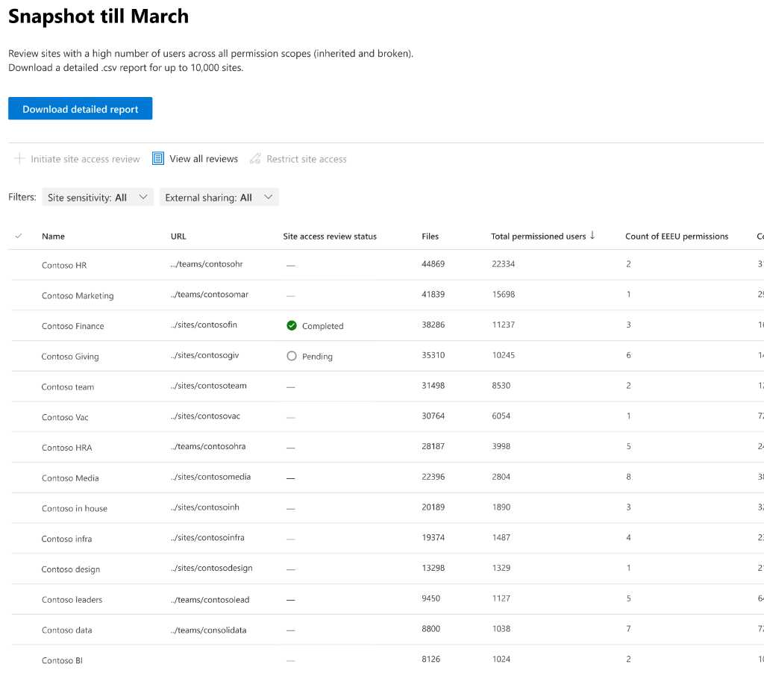
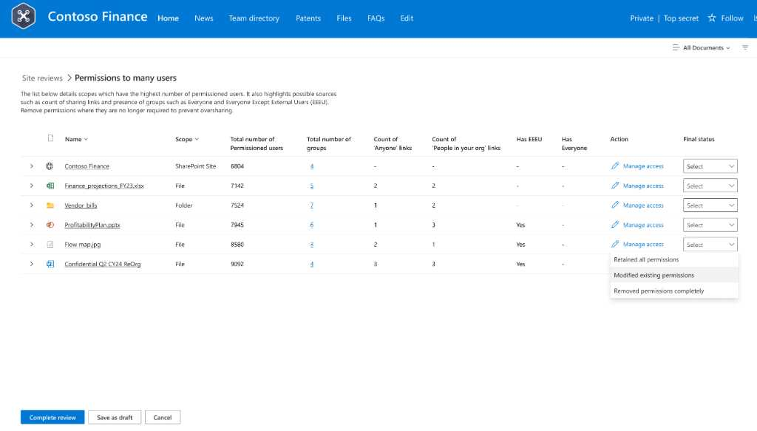
Oversharing control: Permission State Report with Actions
Gain Control Over Site Permissions and Overshared Content
Identify Overshared content:
Customizable and comprehensive permission reports across all sites
Detect root causes of oversharing (broken inheritance, sharing links, EEEUs, site privacy and more)
Focus on critical permissions by user count and extended groups
Integrates with sensitivity labels for enhanced security
Downloadable, with insights from AI analytics
Scalable Actions:
Site Access Review with site owner file review dashboard
Restricted Access Control – limit access to high-risk areas
Restricted Content Discovery – lock down content from Copilot
Broken inheritance, Sharing links, EEEU domain group
Generally available

Slide 34
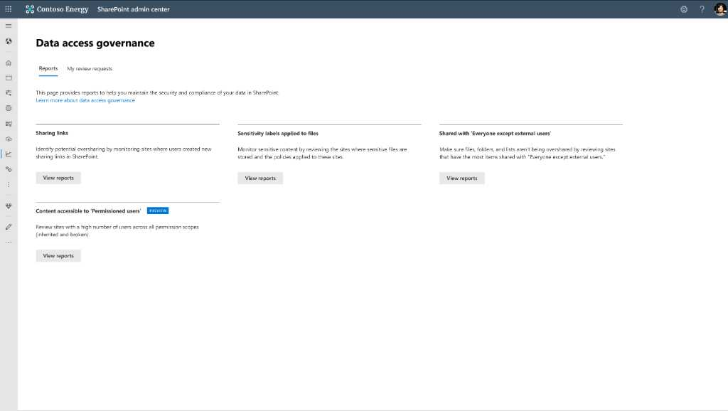
Permission State Report [DEMO]
SCREENSHOTS

Slide 35
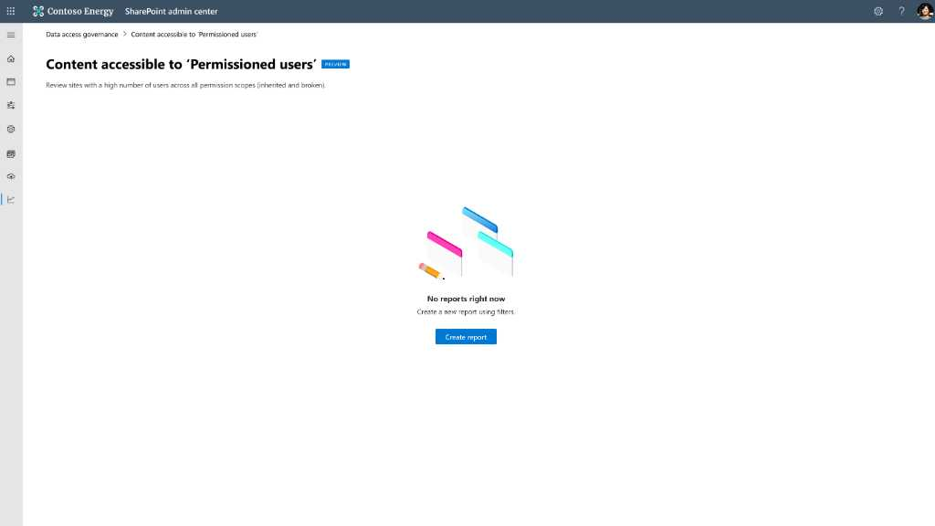
Permission State Report [DEMO]
SCREENSHOTS

Slide 36
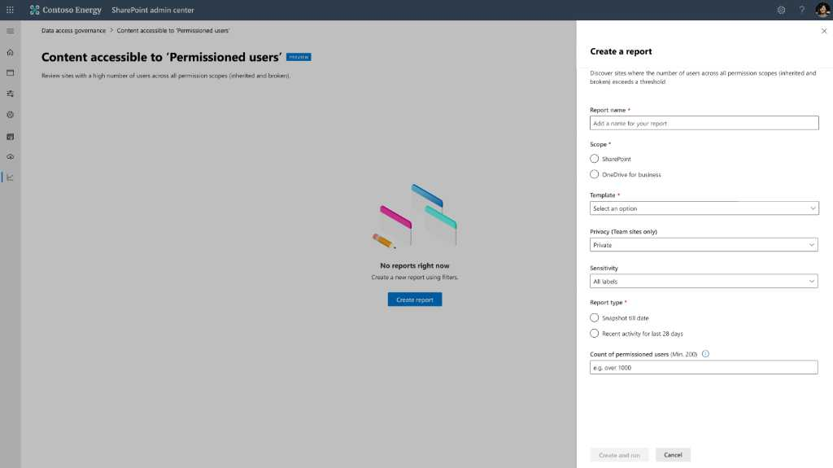
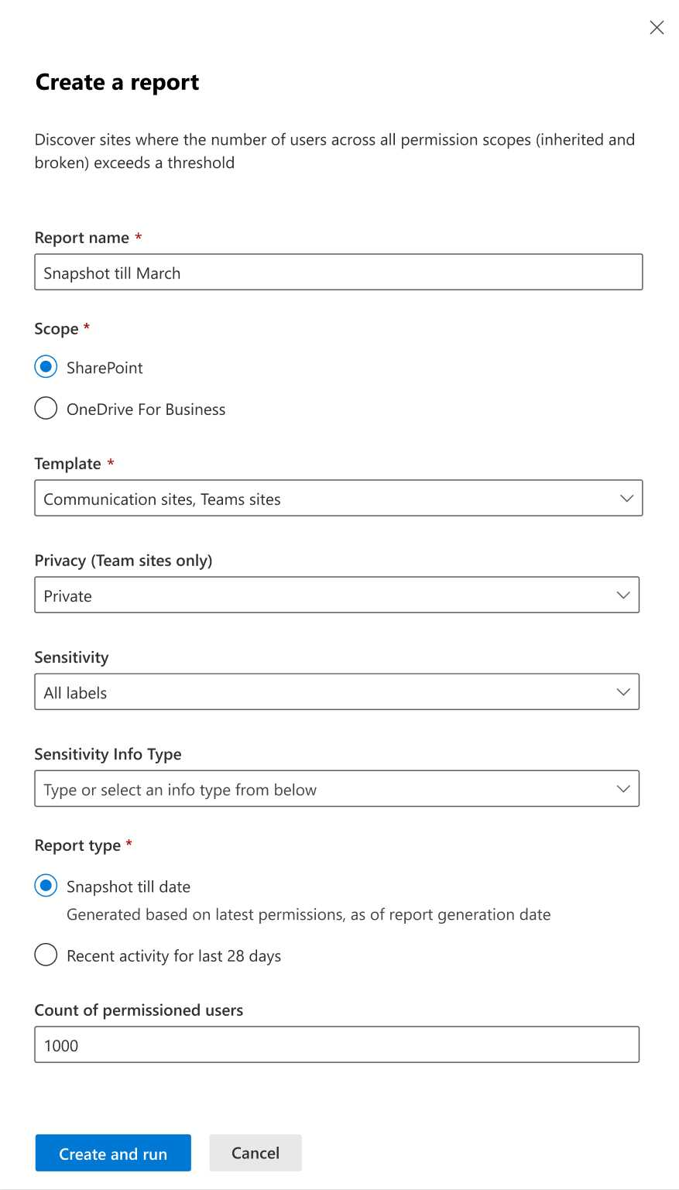
Permission State Report [DEMO]

Slide 37
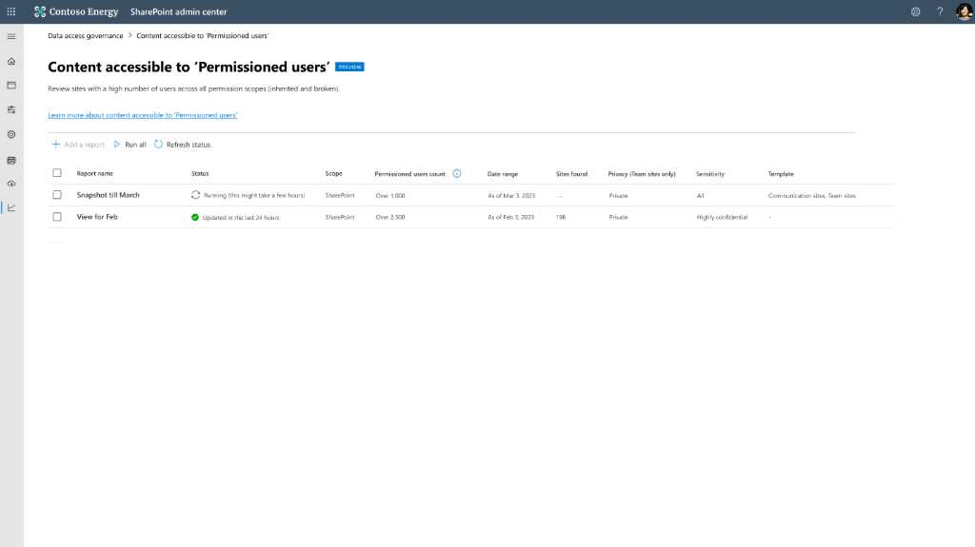
Permission State Report [DEMO]
SCREENSHOTS

Slide 38
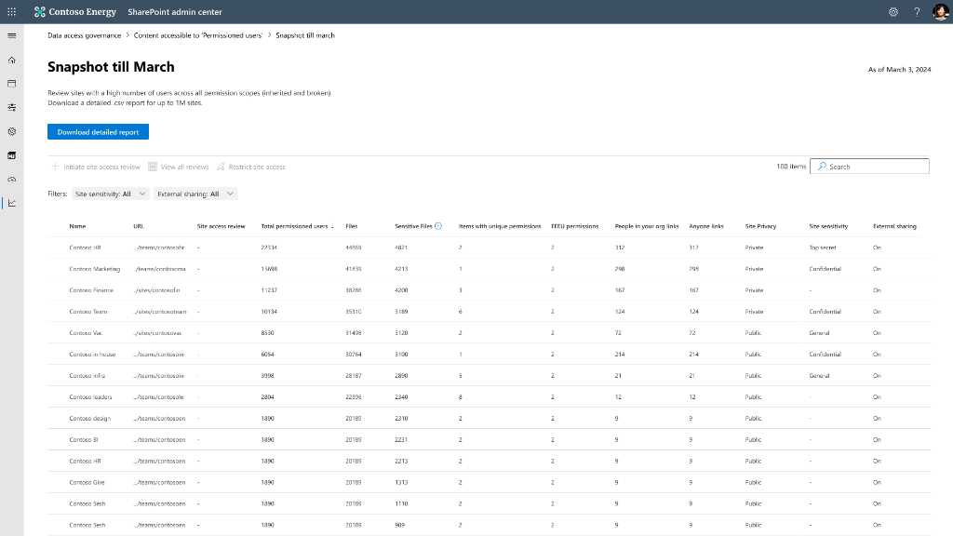
5

Slide 39
6
Use of “everyone except external users” domain group
Files containing sensitive data
Broken permission inheritance
Default sharing option
is everyone
Site privacy set to public

Slide 40
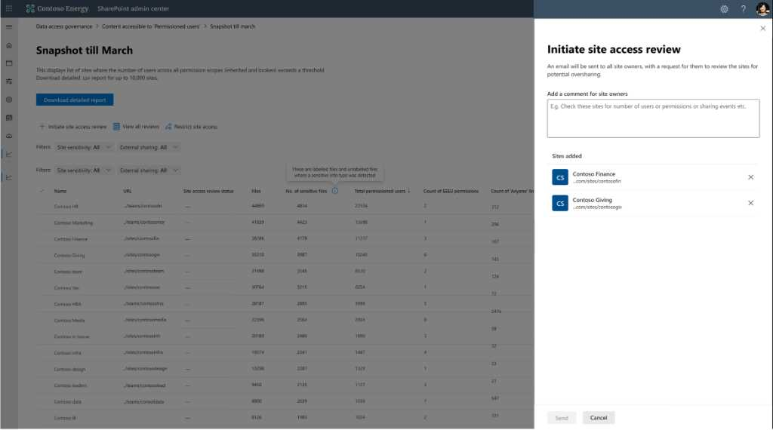
7

Slide 41
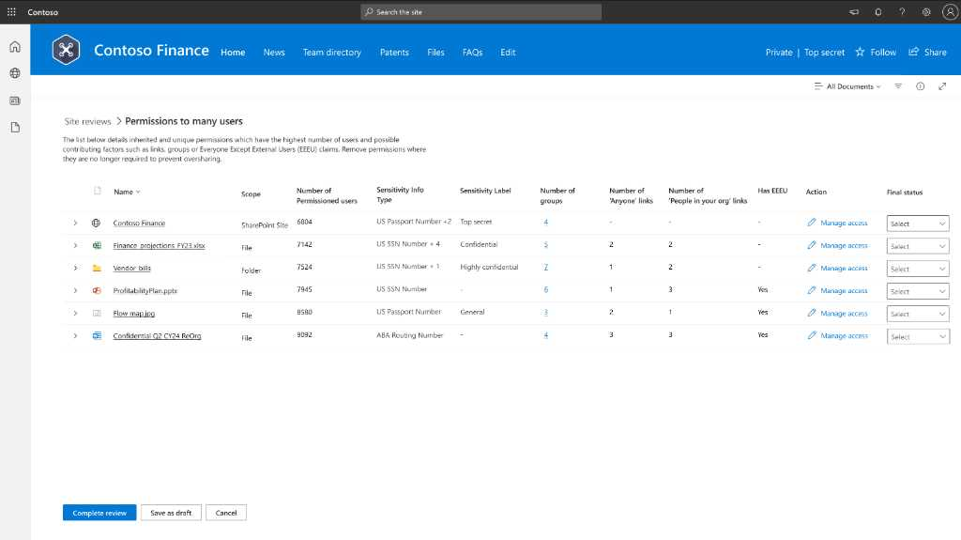
Site Access Review [DEMO]

Slide 42
Site Access Review [DEMO]
Site privacy set to public
Default sharing option is everyone
Broken permission inheritance
Files containing sensitive data
Use of “everyone except external users” domain group

Slide 43
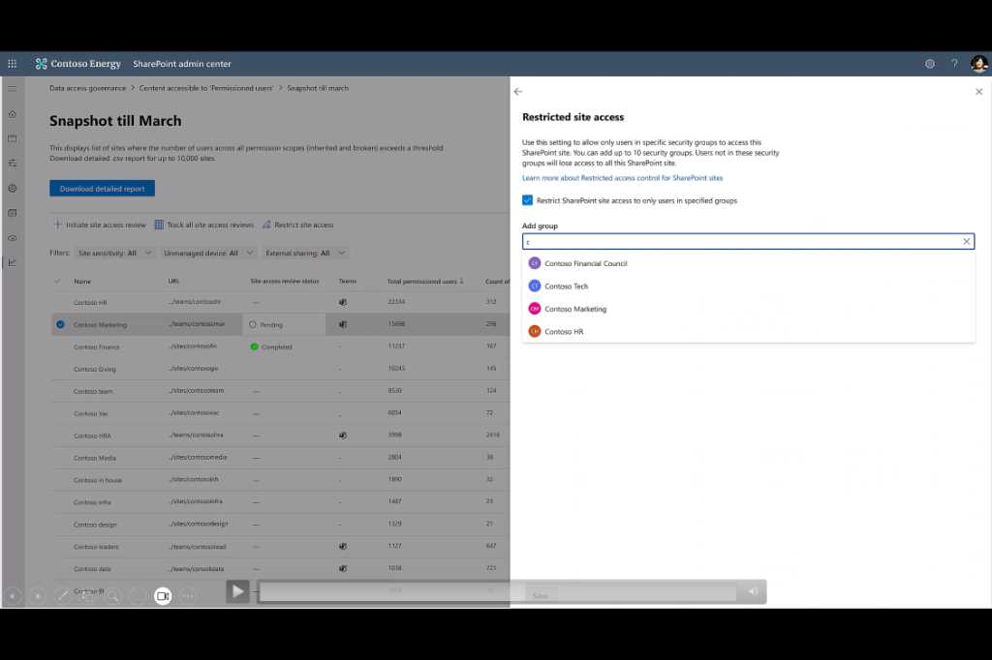
Restricted Access Control (RAC)
for SharePoint & OneDrive
RAC (Restricted access control) policy can be set at the site level. Even if individual files/folders have broken inheritance and over-shared, only RAC allowed users can access
Copilot honors RAC policy!
Microsoft 365 group-connected sites, Non-group SharePoint sites, Teams sites, Shared channel sites, OneDrive sites
Generally available

Slide 44
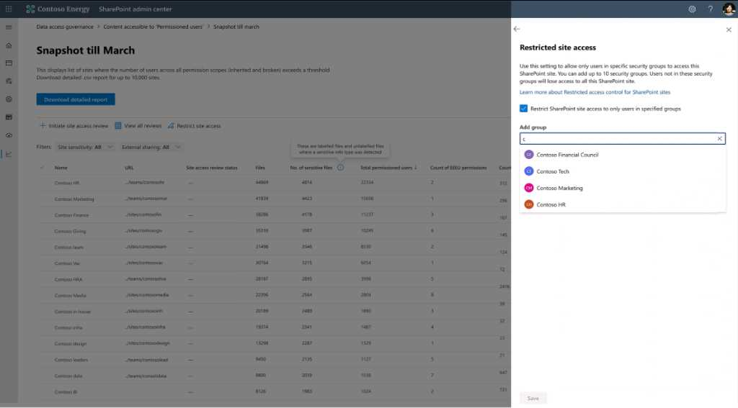
8

Slide 45
Restricted Content Discovery (RCD)
Advanced access control to exclude sites from Copilot
1
2
3
4
Use this site-level setting Restricted Content Discoverability to restrict content discoverability via Copilot and Org-wide search
SharePoint Admin sets this property to a site via PS cmdlet
There is no change to the site’s permissions! > Users continue to have physical access
Contents of the site gets reindexed** – as a result contents are security trimmed and not discoverable via Copilot and tenant-wide search
>Set-SPOSite –Identity <site-url> -RestrictContentOrgWideSearch $true
Public preview
**Standard indexing delays apply, especially with site with large number of files

Slide 46
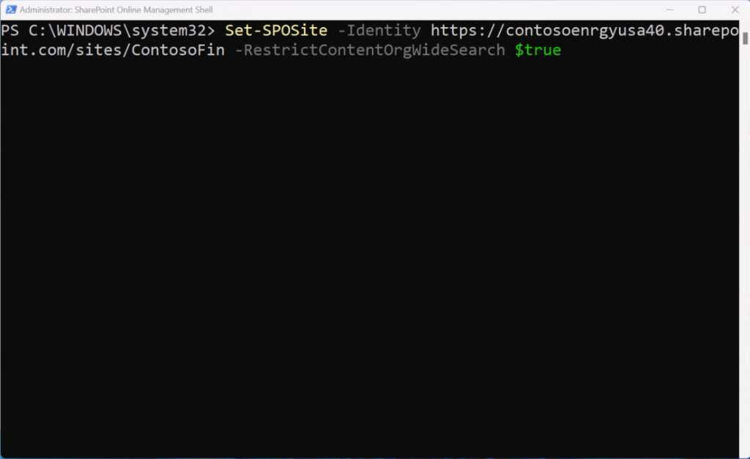
RCD [DEMO]

Slide 47
10
Without SAM

Slide 48
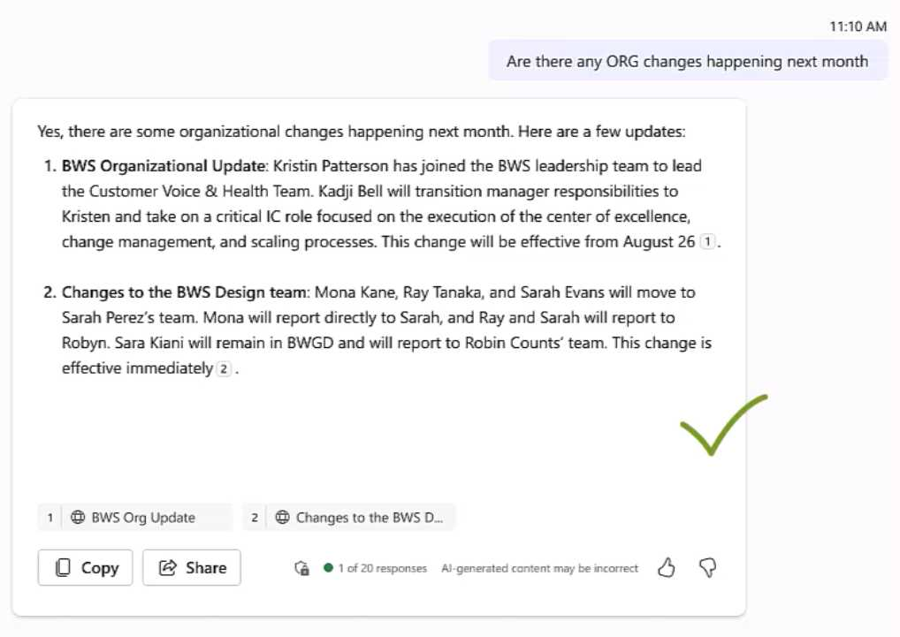
11
With SAM

Slide 49
Oversharing Agenda
1
Intro to Oversharing
2
Oversharing Blueprint
3
Restricted SharePoint Search (Temporary)
4
SharePoint Advanced Management (SAM)
5
Microsoft Purview

Slide 50

Microsoft Purview’s solutions help you secure your AI data like never before
November 2023
May 2024
November 2024
Audit
eDiscovery
Data Lifecycle Management
Communication Compliance
Information Protection
M365 Copilot
Generally Available
Nov 2023
Enterprise-ready on day 0 vs. competitors

Slide 51

Microsoft Purview’s solutions help you secure your AI data like never before
November 2023
May 2024
November 2024
Reports on security and compliance for M365 Copilot activity
Recommendations for a better data security posture
AI-focused policy management
Insider Risk signals
AI regulations coverage with Compliance Manager
DSPM for AI
Public Preview
May 2024
Unlock visibility into AI usage and data security posture

Slide 52

Microsoft Purview’s solutions help you secure your AI data like never before
November 2023
May 2024
November 2024
Data Security Posture Management for AI
Oversharing assessments in public preview
DLP for Copilot in public preview
Purview Blueprint
M365 Copilot
Generally available
Nov 2023
DSPM for AI
Public preview
May 2024
DSPM for AI
Generally Available
Nov 2024
Purview
Generally available
Nov 2023
Rapid Copilot deployment and adoption

Slide 53
Addressing oversharing at file level with Purview
Identify overshared files and sites with new Oversharing assessments surfaced in Data Security Posture Management for AI
1
Keep Copilot from using labeled files in prompts responses with Data Loss Prevention for M365 Copilot and Information Protection sensitivity labels
2

Slide 54
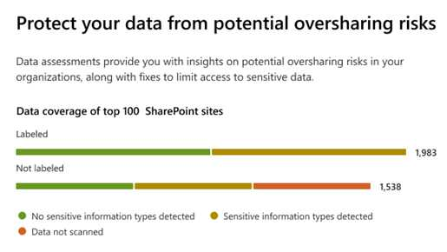
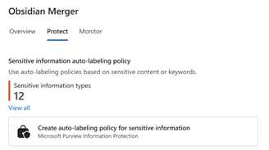
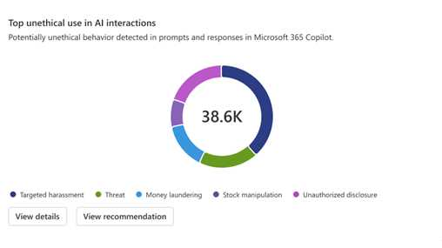
Identify and mitigate risks related to AI usage
Oversharing assessment in Data Security Posture Management (DSPM) for AI
Proactively strengthen data security to help prevent incidents like data oversharing, leakage, or unethical use
Discover data security, safety, and compliance risks in reports and oversharing assessments
Protect sensitive data from overexposure with suggested policies and one click application of sensitivity labels
Govern AI usage for non-compliant or unethical usage and get recommendations on enforcing compliance policies
Now in public preview

Slide 55
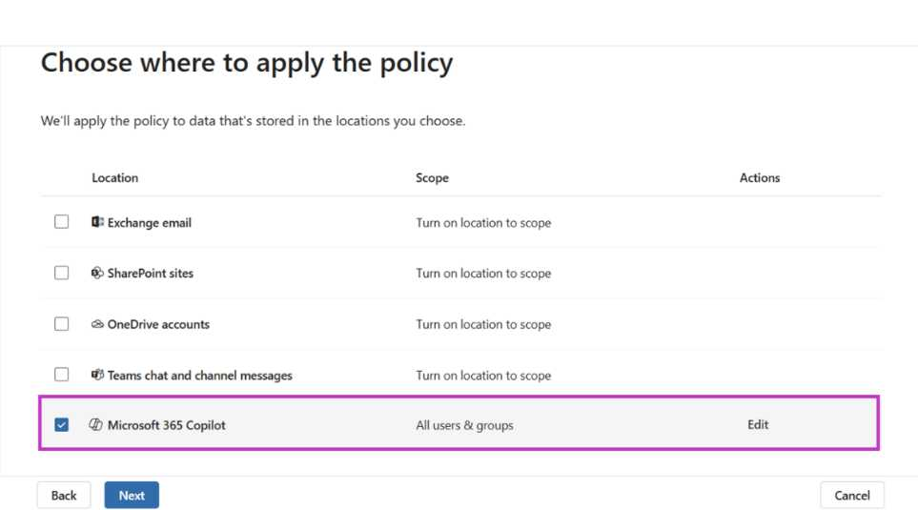
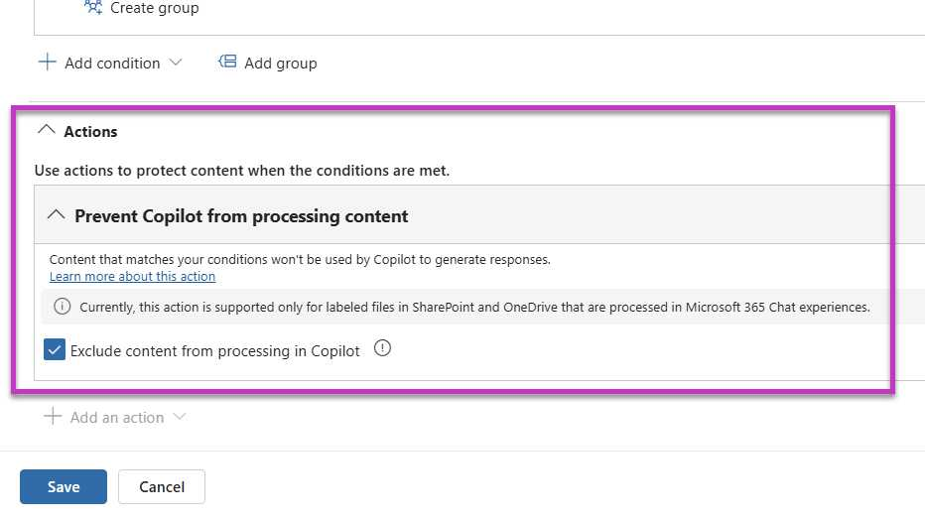
Exclude sensitive files from Copilot processing
Microsoft Purview Data Loss Prevention (DLP) for Microsoft 365 Copilot
Prevent Microsoft 365 Copilot Business Chat from creating summaries or responses for Office or PDF files with specified sensitivity labels
Granular options for policy targeting
Configure restrictions at an item level, group/site level, or for specific Entra user groups.
Prevent Copilot from processing file contents
Ensure that sensitive content within labeled documents is not processed and responses are not available to copy and paste into other applications

Slide 56
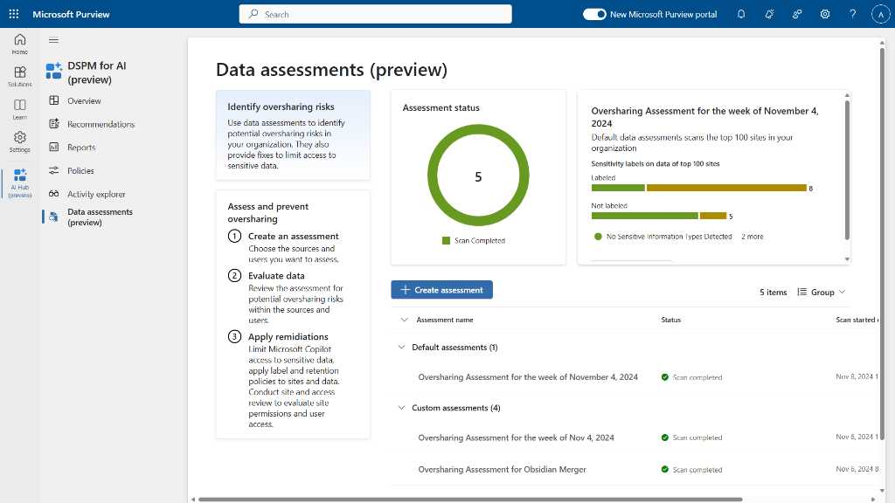
12

Slide 57
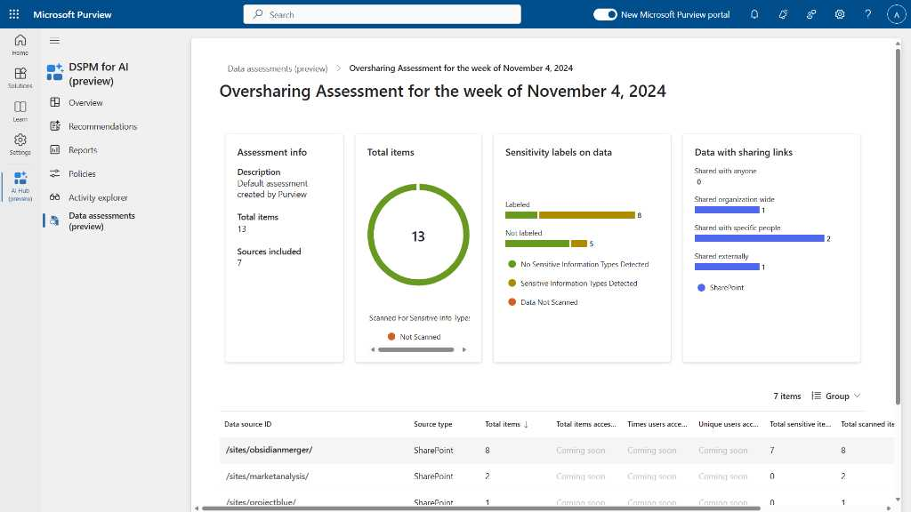
13

Slide 58
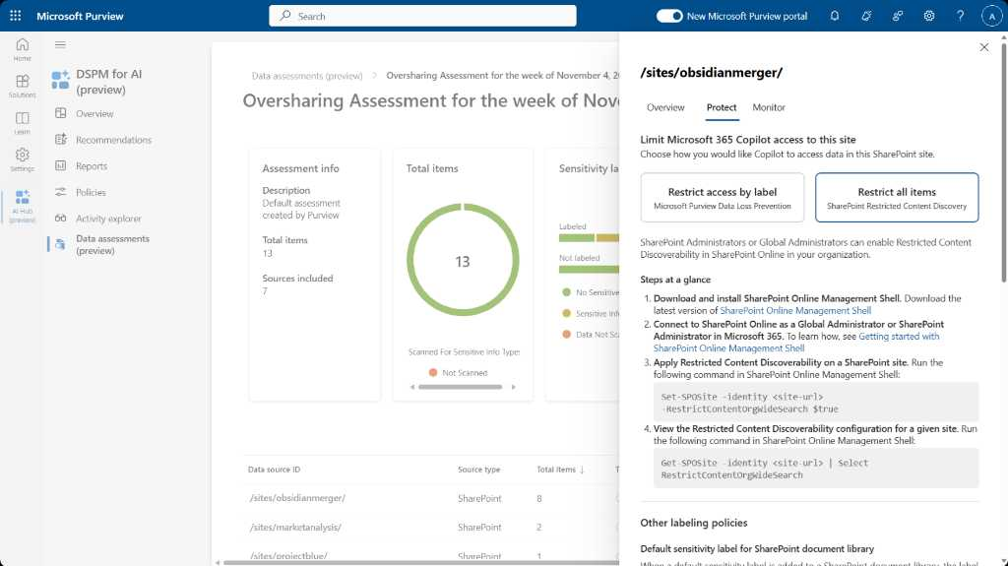
14

Slide 59
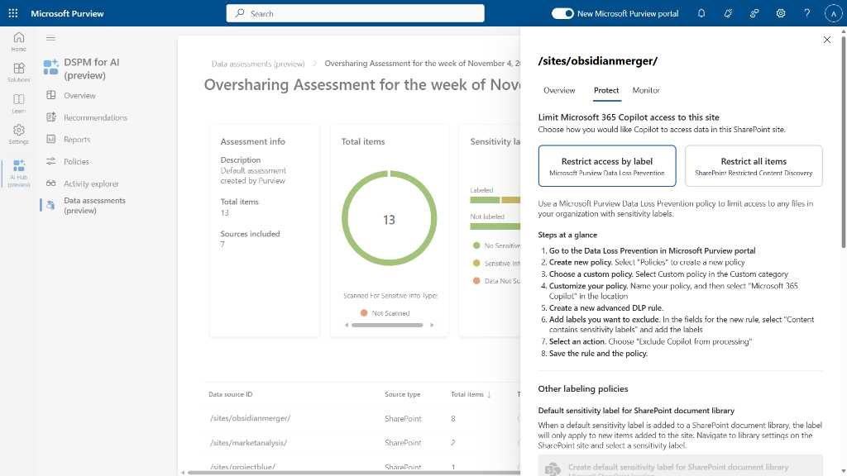
15

Slide 60
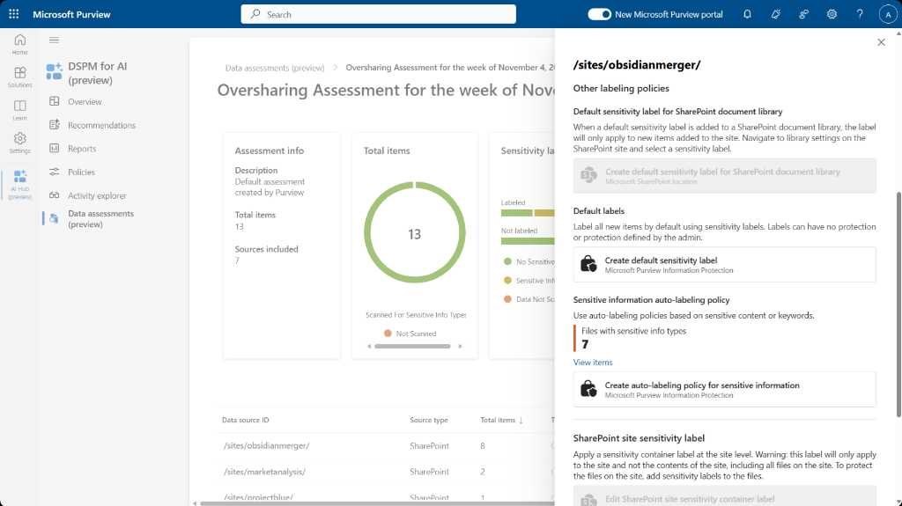
16

Slide 61
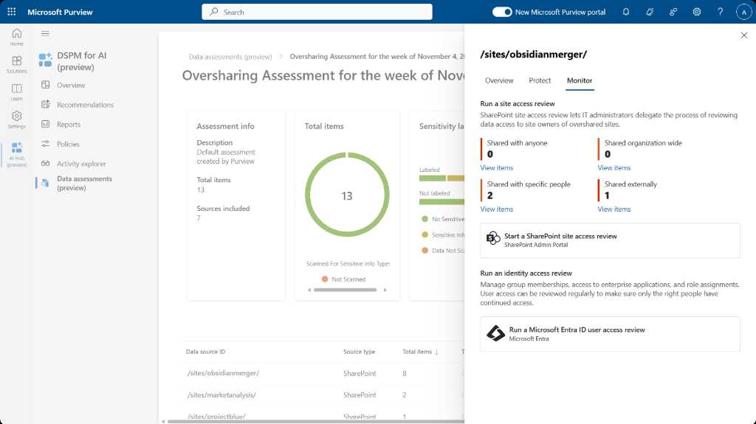
18

Slide 62
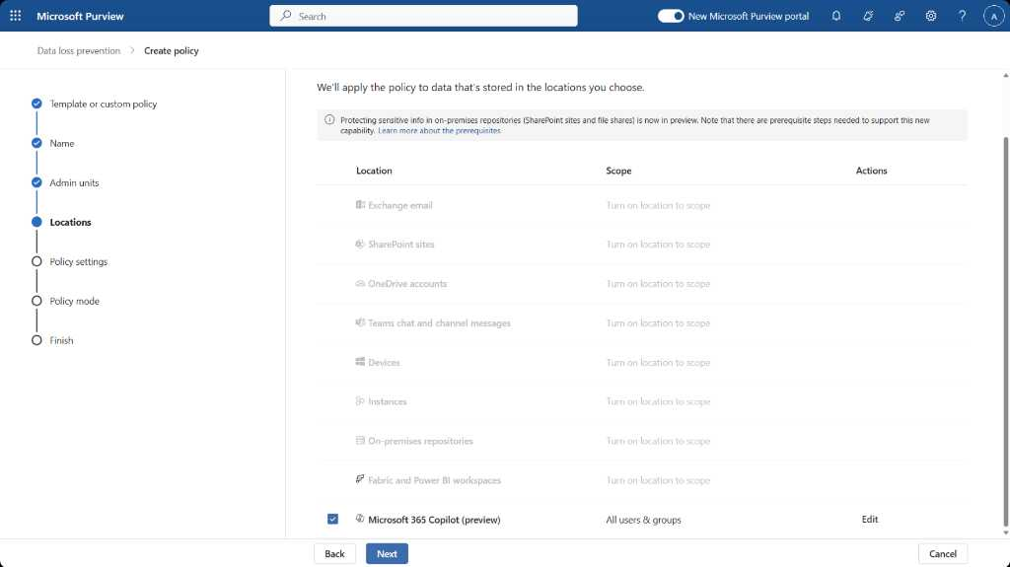
20

Slide 63
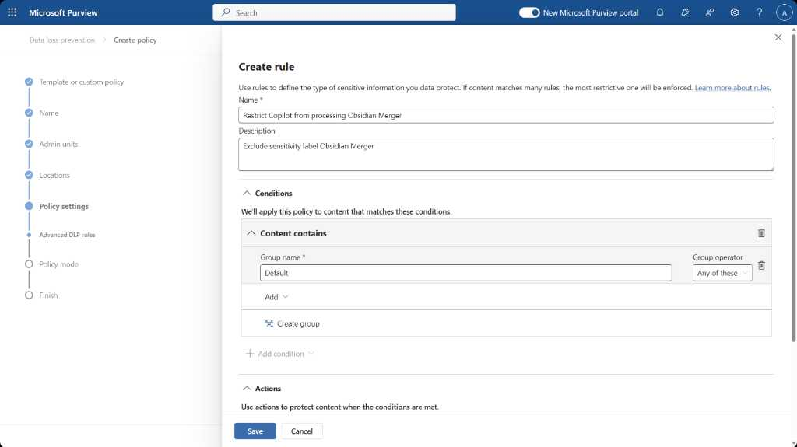
23

Slide 64
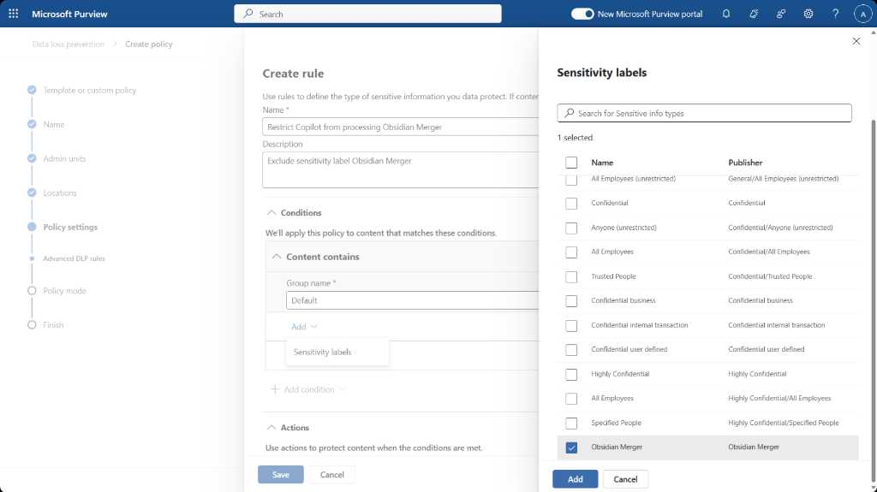
24

Slide 65

25

Slide 66
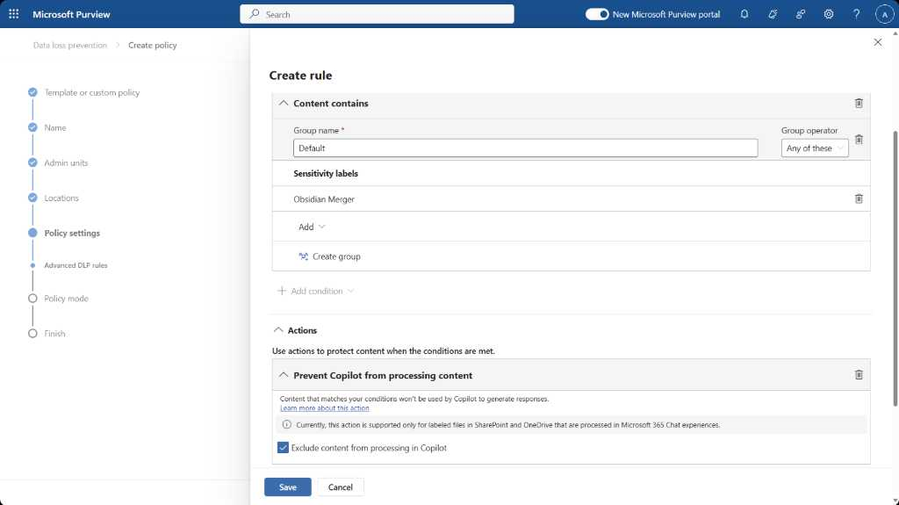
26

Slide 67
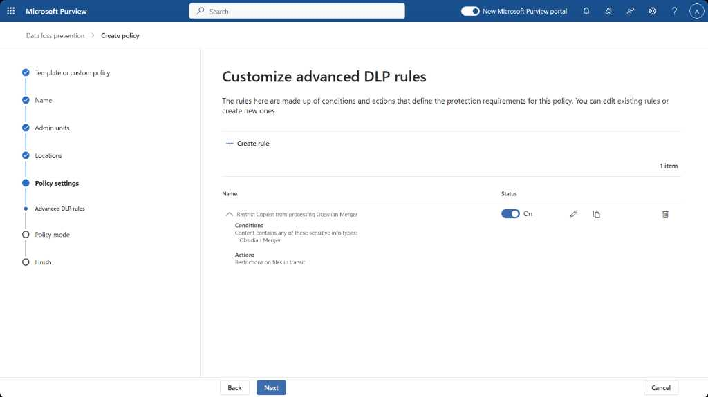
27

Slide 68
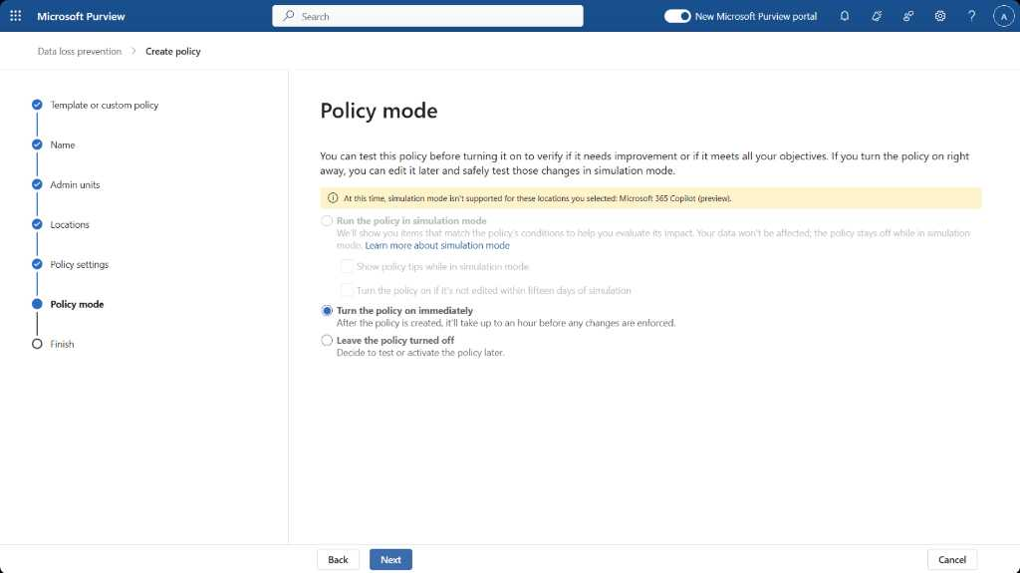
28

Slide 69
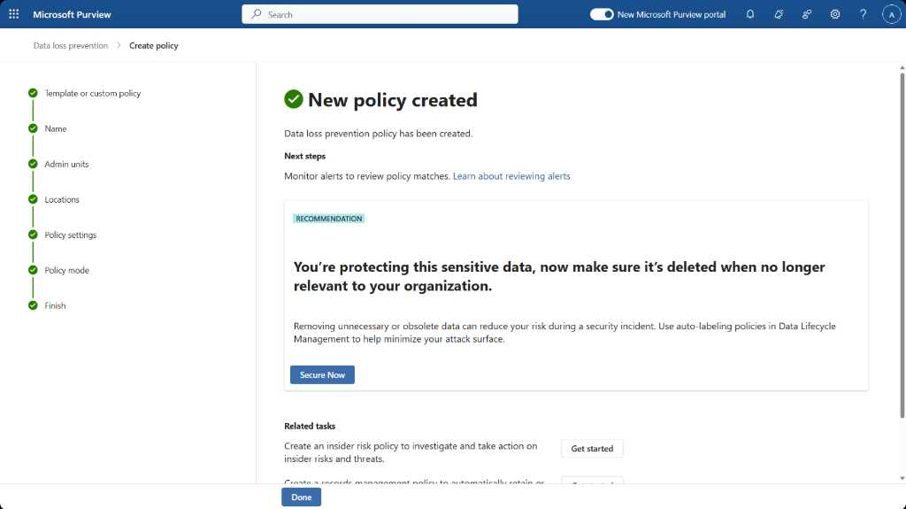
30

Slide 70
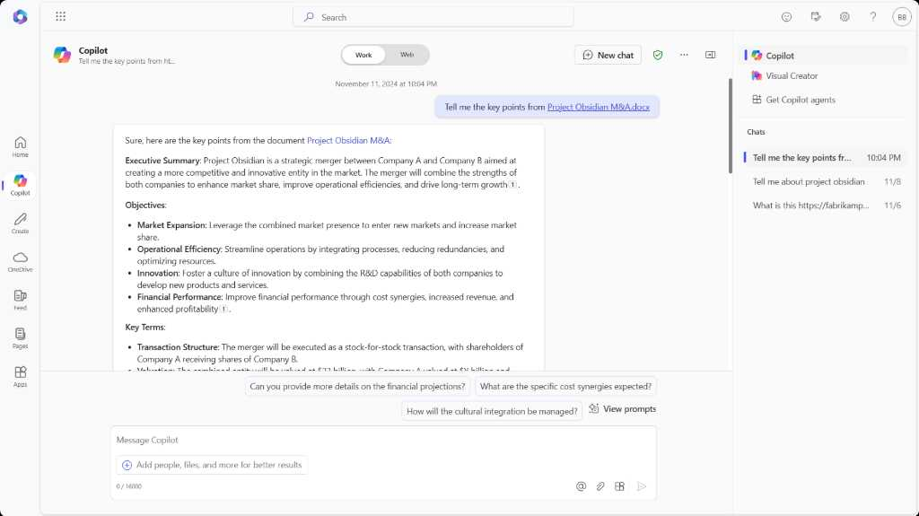
32
User not in DLP Policy

Slide 71
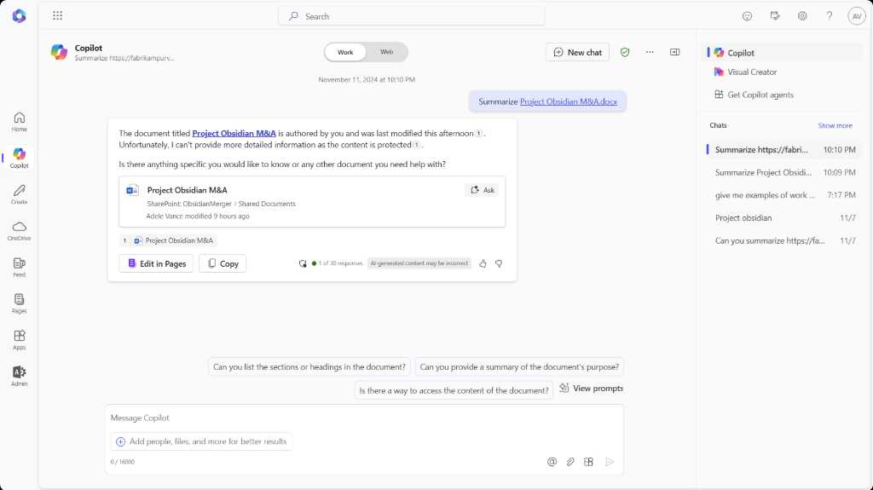
33
User in DLP Policy

Slide 72
Microsoft deployment blueprint to address internal oversharing in Microsoft 365 Copilot
Get the blueprint:
https://aka.ms/Copilot/OversharingBlueprintLearn

Slide 73
Become Copilot Ready

Slide 74
Microsoft 365 Security Features BP, E3, & Add-ons Building a Secure Foundation for Microsoft Copilot
Day 01: Securing Against Internal Threats
Fortify Access
Secure Data
Shield Endpoints
Day 02: Securing Against External Threats
Defend Users
Protect Devices
Become Copilot Ready
Handling Oversharing

Slide 75
Microsoft 365 Security Features BP, E3, & Add-ons Building a Secure Foundation for Microsoft Copilot
Day 01: Securing Against Internal Threats
Fortify Access
Secure Data I
Shield Endpoints
Day 02: Securing Against External Threats
Defend Users
Protect Devices
Become Copilot Ready
Handling Oversharing

Slide 76
Deploy Copilot Blueprint and tools to deploy Copilot with your customers
Become Copilot Ready Tools and guidance to implement Microsoft Security
"External threats are becoming more sophisticated, targeting not just users but entire systems and infrastructures."
"With comprehensive external protection, organizations can confidently adopt AI-driven tools and foster collaboration."

Slide 77


Microsoft 365 Security Features BP, E3, & Add-ons Building a Secure Foundation for Microsoft Copilot
Day 01: Securing Against Internal Threats
Fortify Access
Secure Data I
Shield Endpoints
Day 02: Securing Against External Threats
Protect Devices
Defend Users
Secure Data II
Become Copilot Ready
Handling Oversharing

Slide 78



The secure productivity foundations for Copilot
Power AI
productivity
Protect your business
Simplify IT
management
Introduce Generative AI with Commercial Data Protection.
Best in class productivity apps
Zero Trust Security Foundations
Embrace Enterprise grade AI with confidence by safeguarding your business
Streamline IT management
Cut costs and complexity
Increase security across endpoint and applications
*Microsoft Teams and Copilot for Microsoft 365 are available as standalone offers purchased separately.

Slide 79








Becoming Copilot Ready Layered Security
Microsoft 365 Business Premium
Identity and access controls
Device management
Device security
Email and app security
Data security
Microsoft Entra ID Plan 1
Multi-Factor authentication to protect against password loss
Passwordless authentication
Self Service Password Reset
Conditional Access to provide access controls to work data
Cloud App Discovery to discover Shadow IT
Microsoft Intune
Centralized management of mobile and desktop, Mac devices
Enforce that work data is only accessed via authorized apps
Remote wipe of data of lost and stolen devices
Enforce strong pin requirements and disk encryption​
Manage Wi-Fi, VPN certificates ​
Microsoft Defender for Business
Ransomware protection with AI powered EDR with automatic attack disruption
Next gen-AV protection
Protection across Android, iOS, Max, Windows and Linux
Threat and vulnerability management
Monthly summary reports
Microsoft Defender for Office 365
AI powered LLM based threat protection
Phishing and malware defense across email, Microsoft Teams, OneDrive and SharePoint
SafeLinks with time of click URL filtering
Safe Attachments with real-time attachment scanning in sandbox
Microsoft Purview
Data Loss Prevention to protect sensitive data such as credit card or social security numbers
Classify and label sensitive data
Apply protection such as “Do Not Forward” or “Encrypt Email”
Audit, search and legal hold

Slide 80




Secure and govern Copilot with Microsoft Security
Foundational
Core
Best-in-class
Microsoft 365 Copilot
+ Business Basic
+ Business Standard
Microsoft 365 Copilot
+ Business Premium
+ Microsoft 365 E3
+ SharePoint Advanced Management
Microsoft 365 Copilot
+ Microsoft 365 E5
+ SharePoint Advanced Management
Multi-factor Authentication
Audit logging
Search and export
Retention or deletion policies
Restricted SharePoint Search
Conditional Access
Manual sensitivity labels
Data loss prevention policies
Advanced SharePoint sitewide access controls and reporting
Search, export, eDiscovery case management, and legal hold
Conditional Access based on identity risk
Automatically apply sensitivity labels
Automatically remove inactive content
Prevent data leak on endpoint devices
Detect non-compliant usage

Slide 81


Additional offerings for small and medium businesses
Data protection add-ons
Productivity add-ons
Information protection and governance
Insider risk management
eDiscovery and audit
Clipchamp Premium
Teams Phone Standard
Discover, classify, and protect sensitive information wherever it lives or travels
Detect, investigate, and act on malicious and inadvertent activities
Search and export content in Microsoft 365 and Office 365
Video editing app with advanced features incl. brand kit, advanced 4K/60 fps output, generative AI
Cloud-based telephony using VOIP or PSTN
$7/user/month
$6/user/month
$6/user/month
Intro. price: $5/user/month
$8/user/month

Slide 82
Resources

Slide 83
Links to learn more (1 of 2)
Copilot Readiness Hub
What is Copilot?
Introducing Copilot for Microsoft 365
The Copilot System
ChatGPT vs. Copilot for Microsoft 365: What's the difference?
How Copilot works
How Copilot for Microsoft 365 works: Microsoft Mechanics video
Semantic Index for Copilot
Microsoft Graph
Microsoft Graph connectors
Additional copilot experiences across the Microsoft Cloud
Microsoft Dynamics 365 Copilot
Copilot in Power Platform
Microsoft Security Copilot
GitHub Copilot
Copilot in Microsoft Stream
Privacy
Microsoft’s privacy policy
Microsoft Privacy Statement
Trust Center data protection and privacy
Data, privacy, and security for Copilot for Microsoft 365
Data, privacy, and security for Azure OpenAI Service
Role-based access control
User permissions and permission levels in SharePoint Server
Customer Lockbox requests
Microsoft 365 isolation controls
Data Protection Addendum

Slide 84
Links to learn more (2 of 2)
Data residency and storage
EU Data Boundary
Website
Blog
Documentation
How to prepare for Copilot for Microsoft 365
Learn about Microsoft feedback for your organization
Manage Microsoft feedback for your organization
How to manage Microsoft Search
Microsoft 365 Product Terms
Content management and security in SharePoint, OneDrive, and Teams
Compliance
Microsoft Compliance
Service Trust Portal
Compliance offering definitions
General Dat Protection Regulation (GDPR)
Full summary
Short summary
Security
Configure usage rights for Azure Information Protection (AIP)
Universal Licensing Terms for Online Services
Data Protection Addendum
Isolation and Access Control in Microsoft 365
Responsible AI
Responsible AI core principles
Videos
Documentation
Microsoft Responsible AI Standard
Governing AI: A Blueprint for the Future

Slide 85
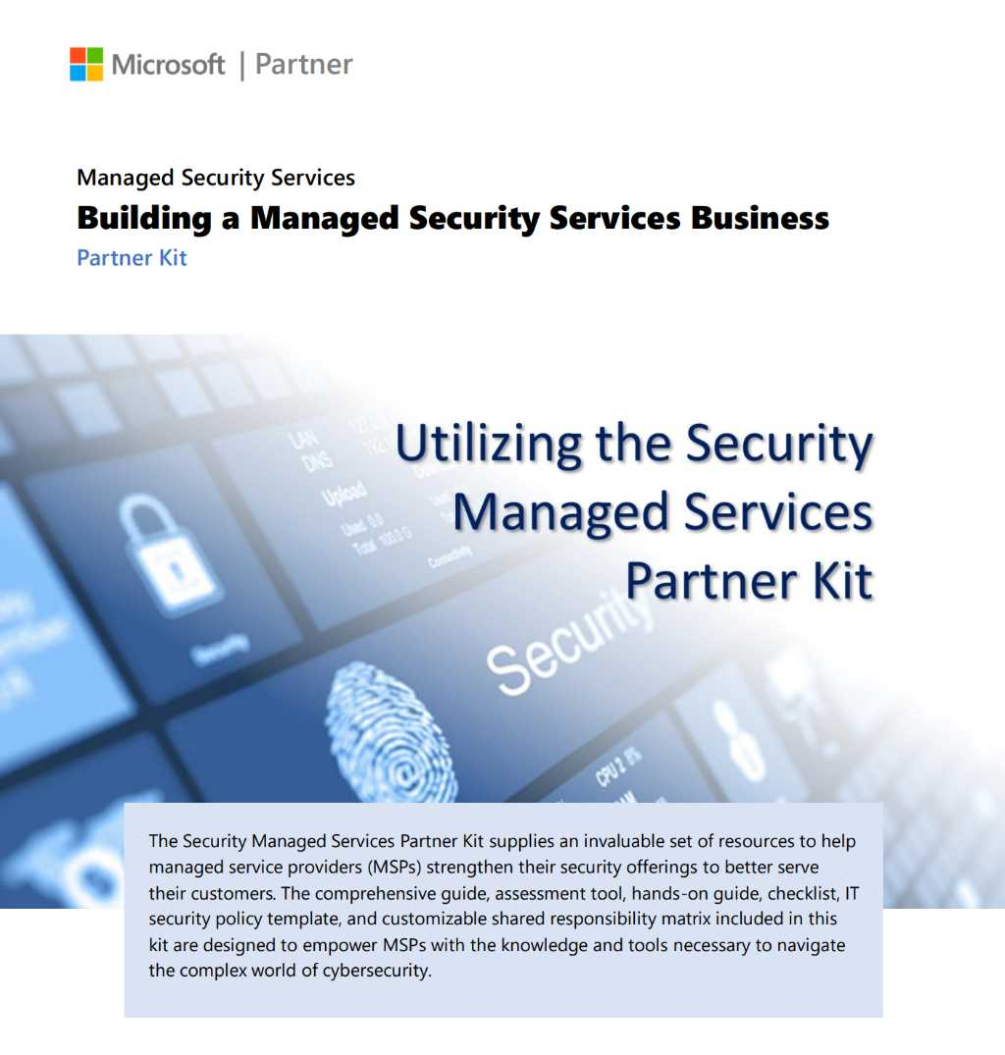

Utilizing the Security Managed Services Partner Kit
Provides step-by-step guidance for building and expanding managed services with Business Premium.
Microsoft 365 SMB Security Managed Services Partner Kit

Slide 86
New security managed services partner kit
1
Grow recurring revenue and profitability with security managed services
2
Use AI driven sales insights and M365 Lighthouse multitenant management to increase success
3
Increase customer loyalty and partner share of wallet
Step by step guidance on how to begin with services
Practical guidance on expanding from IT management to security
Integration with security frameworks and key partner tools
https://aka.ms/SMBManagedServices

Slide 87




Learn more
Get started with Microsoft 365 Business Premium
Discover how Hollen boosts security with Microsoft 365 Business Premium in this customer story
Learn the top 5 benefits of Microsoft 365 Business Premium
Read all about AI-powered Copilot for Microsoft 365

Slide 88

Session resources
Get started: aka.ms/M365Lighthouseonboard
Learn more: aka.ms/M365Lighthouse
Microsoft 365 Lighthouse FAQ: aka.ms/M365LighthouseFAQ
Sales Advisor demo video: aka.ms/M365SalesAdvisorWalkthrough
Microsoft 365 Lighthouse datasheet: aka.ms/M365LHDatasheet
Microsoft 365 Lighthouse blog: aka.ms/Microsoft365LighthouseBlog
Access technical documentation: aka.ms/M365LighthouseDocs
Share your feedback: aka.ms/M365LighthouseFeedback
Microsoft 365 Lighthouse Demo
Sales Advisor Demo

Slide 89

Copilot for Microsoft 365 Monthly updates for partners!
https://aka.ms/WhatsNewCopilot

Slide 90
NEW! Level Up CSP Q3 technical lab series
Virtual hands on labs series (max 70 attendees, held in English) – first come first serve
Security
Copilot Studio agents
Apply data protection policies to prepare for Copilot
Deploy and manage endpoints
Protect identities
Build your first Copilot Studio agent
Build agents serving internal and external use cases
Technical best practices
February 12 at 8:00am-12:00pm PT
February 19 at 8:00am-12:00pm PT
Register at aka.ms/LevelUplabsecurityseries
Register at aka.ms/LevelUpLabagentseries

